Slide 1
History and clinical examination to oedema
Dr. Varun. S
Dept. of . Surgery
Skhmc

Slide 2
HOW TO TAKE A HISTORY????
I. APPEARANCE
LOCALISED
GENERALISED
CELLULITIS
LYMPHANGITIS
VENOUS OBS.
CARDIAC
RENAL
LIVER D/S
HYPOALBUMINEMIA
HYPOTHYROIDISM

Slide 3
II. ONSET
SUDDEN
INSIDIOUS
A/C NEPHRITIS
A/C ANAPHYLAXIS

Slide 4
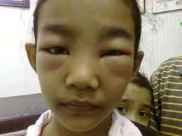
III.FIRST SITE OF APPEARANCE
PERIORBITAL AREA
RENAL CAUSE

Slide 5
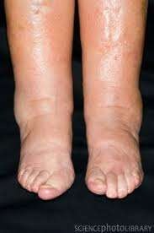
Cont…….
DEPENDANT PART
CARDIAC OEDEMA
LEG
SACRUM

Slide 6
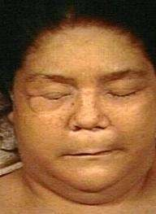
IV.OTHER SYMPTOMS
1.
CONSTIPATION
COLD INTOLERANCE
FEELING SLEEPY
HYPOTHYROIDISM

Slide 7
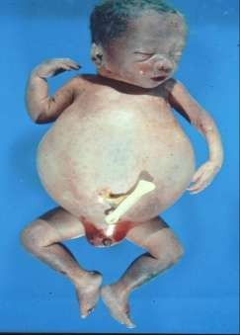
Cont…….
2.ARE THERE ANY FEATURES OF NUTRITIONAL DEFECIENCY
STARVATION/MALNUTRITION
HYPOROTEINEMIA

Slide 8
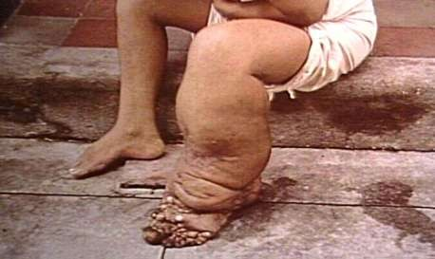
Cont…….
4.R/C ATTACKS OF FEVER + RIGOR
H/O FEVER + SIGNS OF INFLAMMATION
FILARIASIS/ CELLULITIS/LYMPHA NGITIS

Slide 9
Cont…….
5.DOES THE PAT. HAVE HEMIPLEGIA AND IS THE OEDEMA ON PARALYSED SIDE?
PARALYSIS DEC. LYMPHATIC N VENOUS DRAINAGE
U/L OEDEMA OCCURS DUE TO LESIONS IN CNS WHICH AFFECTS THE VASOMOTOR FIBRES ON ONE SIDE….

Slide 10
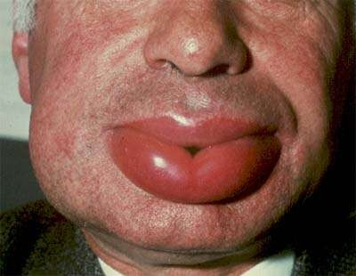
V. ASSOCIATED FEATURES
OLIGURIA & SMOKY URINE
NEPHRITIS
ORTHOPNOEA & PND
CARDIAC CAUSE
URTICARIA & MANI. OF ALLERGY
ANGIODEMA

Slide 11
Cont…….
GI SYMP.
CIRRHOSIS OF LIVER
ASCITES
CHEST PAIN & COUGH/ DYSPNOEA
MEDIASTINAL OBS. DUE TO TUMOUR
SIGNS OF INFLAMMATION OVER AREA
INFLAMMATORY CAUSE

Slide 12
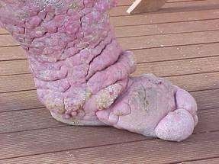
VI. PAST, PRESENT & FAMILY HISTORY
PAST H/O
CARDIAC,RENAL OR LIVER D/Sa
FAMILY H/O OEDEMA
MILROY’S OEDEMA

Slide 13
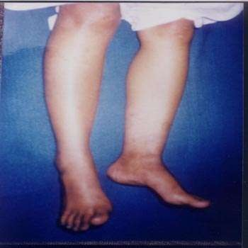
Cont…….
DRUG HISTORY
NIFEDIPINE,ESTROGEN,STEROIDS,NSAID
IS THE PAT. PREGNANT U/L PEDAL OEDEMA

Slide 14
Cont…….
RELATION SHIP TO MENSTRUAL PERIODS
CYCLICAL OEDEMA(PERIODICAL)
H/O SURGERY & PROLONGED TRAVEL
DVT

Slide 15
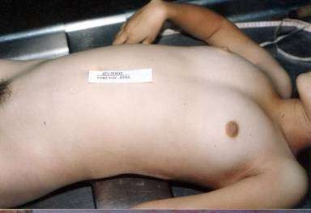
EXAMINATION OF PATIENT
GENERAL EXAMINATION
BUILT & NOURISHMENT
POORLY NOURISHED IF OEDEMA IS DUE TO ANY NUTRITIONAL DEF….
PALLOR
CARDIAC/GI CAUSES

Slide 16
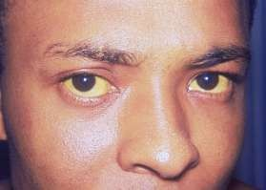
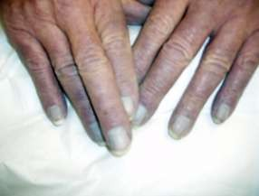
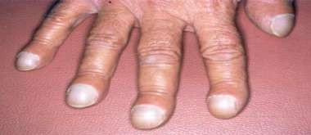
Cont…….
3.ICTERUS
CIRRHOSIS OF LIVER
4.CYANOSIS &
CLUBBING
CARDIAC OEDEMA

Slide 17
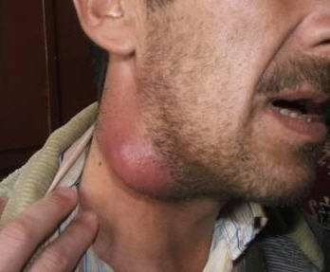
Cont…….
LYMPHADENOPATHY
FILARIASIS
OEDEMA
ITALS

Slide 18
HOW TO DEMONSTRATE OEDEMA CLINICALLY?????
1. SITTING PATIENT
OVER MEDIAL MALLEOLUS OR 5cm ABOVE IT……….WITH RIGHT THUMB………APPLY PRESSURE FOR MINIMUM 30 SEC…..
ALMOST ALLWAYS LOOK FOR DIMPLE…..AFTER APPLYING PRESSURE….OTHERWISE WE CAN MISS A CASE OF MINIMAL OEDEMA….

Slide 19
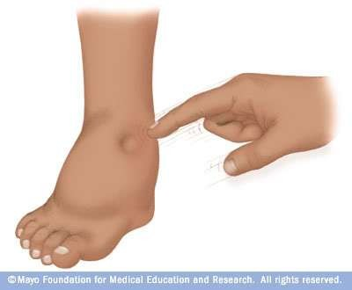
Cont…….

Slide 20
Cont…….
2.AMBULATORY PATIENT……
APPLY PRESSURE OVER SACRUM WITH RIGHT THUMB FOR
30 sec…….AND LOOK FOR DIMPLE……

Slide 21
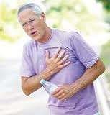
EXAMINATION OF PATIENT WITH CARDIAC
OEDEMA………….
1.INSPECTION
DYSPNOEIC
ENGORGED OR PULSATILE VEINS IN
NECK……
2.PALPATION
PITTING OEDEMA,
SOFT TENDER HEPATOMEGALY
APEX OUTSIDE MCL
CARDIOMEGALY

Slide 22
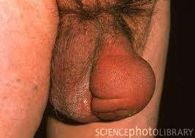
Cont…….
3.AUSCULTATION
MAY BE ASSO. WITH RV GALLOP RHYTHM…..
EXAMINATION OF PATIENT WITH RENAL OEDEMA………..
INSPECTION
PERI ORBITAL OEDEMA
SWELLING OF SCROTAL SACS

Slide 23
Cont…….
2.PALPATION
PITTING OEDEMA
PERCUSSION & AUSCULTATION ARE LESS
SIGNIFICANT………
EXAMINATION OF PATIENT WITH
ASCITES………………….
INSPECTION
GENERALISED SWELLING OF ABD….FLANKS USUALLY FULL….UMBILICUS EVERTED…….

Slide 24
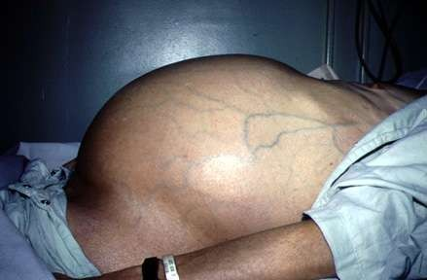
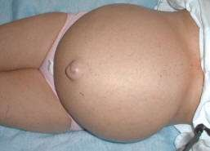
Cont…….

Slide 25
Cont…….
2.PERCUSSION
PUDDLE SIGN -120 ml
FLUID THRILL
SHIFTING DULLNESS – 1000-1500 ml
(CONFIRM DIAGNOSIS)

Slide 26
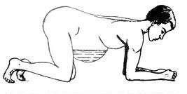
PUDDLE SIGN…

Slide 27
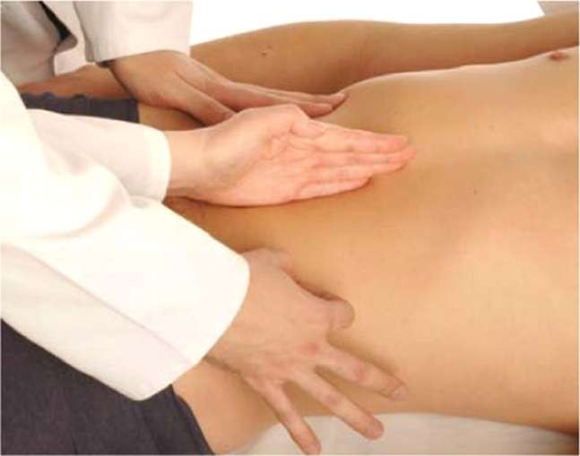
FLUID THRILL…….

Slide 28
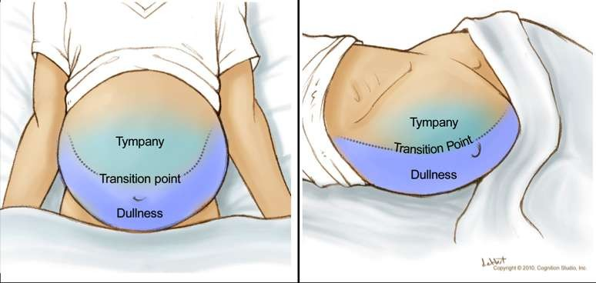
SHIFTING DULLNESS……..

